Slide 1
Parabolic SAR + McGinley Indicator Strategy
Rahul Siddharth

Slide 2
Strategy & Idea
Uses Parabolic Switch and Reverse to detect the direction of an assets movement & possible reversal points.
Solution? Include Mcginley Dynamic Indicator to act as smoothing moving-average adjacent indicator that dynamically responds to price movements.Use both Mcginley Dynamic Indicator and Parabolic SAR to determine buy/sell signals.
However, it is a lagging indicator behind real time data.

Slide 3
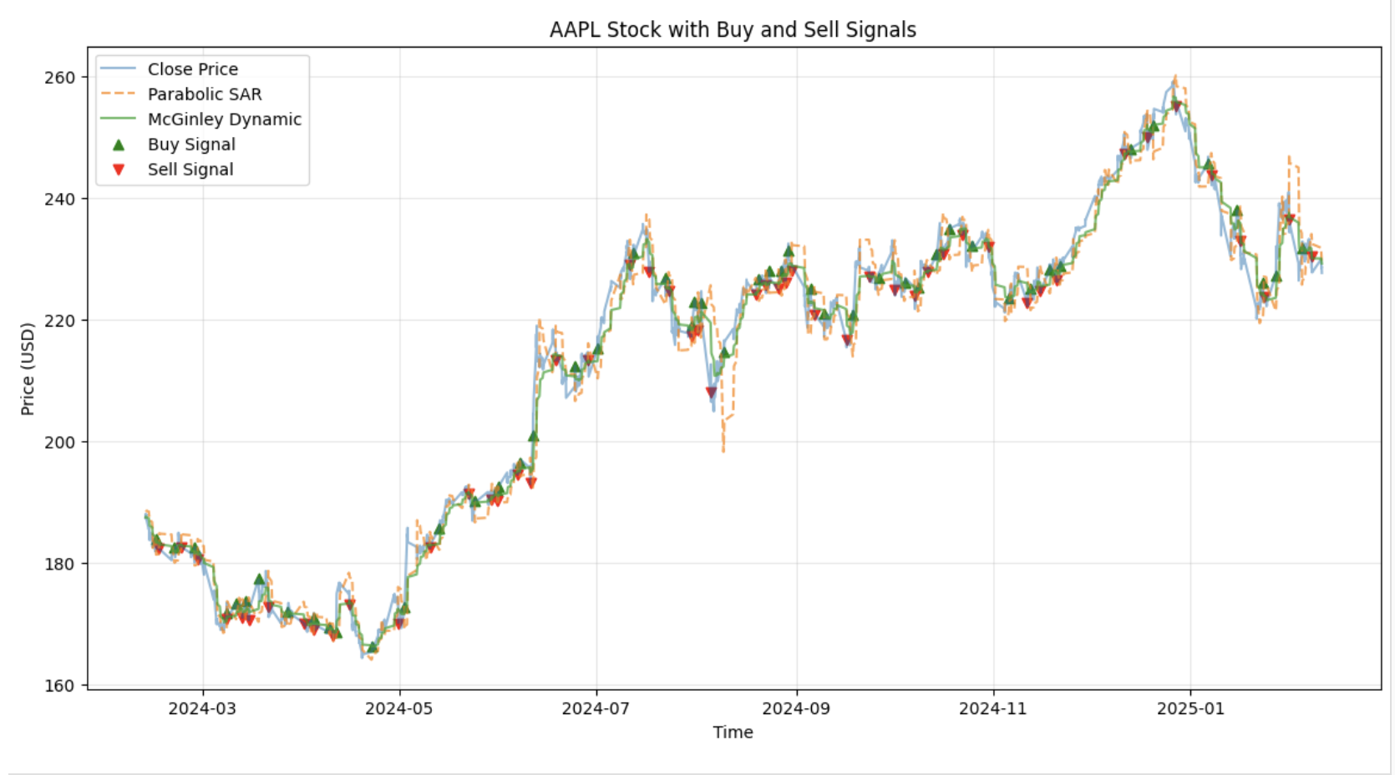
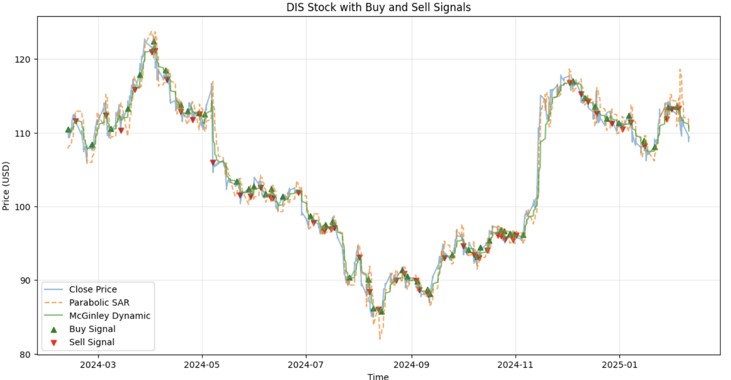
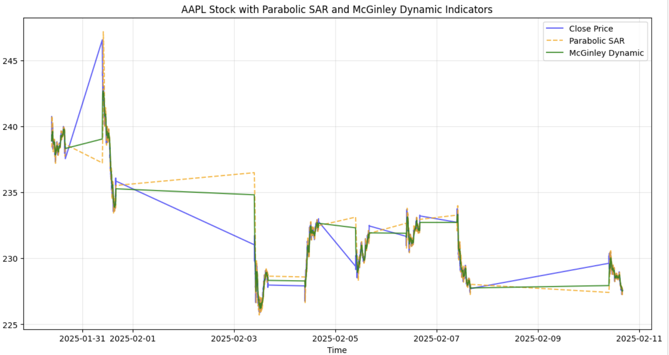
Performance(Strong Trends v. Sideways Trends)
Makes profit In both Uptrend and Downtrend(for longer periods of time)
Sideways Trends(small time frame), negative profit

Slide 4
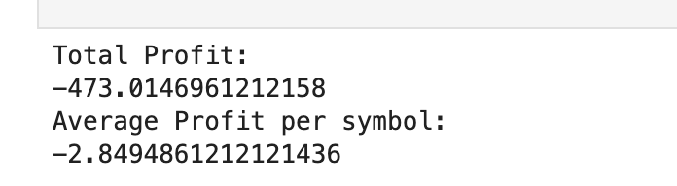

General Performance Across Various Symbols
Ran performance on a bunch of symbols across multiple sectors on two time periods: 1yr of data with 1hr intervals and 8 days of data with 1 minute intervals(Profit likely not best indicator, but offers some measure of progress).
Performance Across 1 year using 1 hour intervals
Performance Across 8 days and using 1 minute intervals

